Slide 1
Operating Systems
CHAPTER-5
I/O Management & Disk Scheduling

Slide 2
I/O Buffering
Input/Output
The process of temporarily storing data that is passing between a processor and a peripheral. The usual purpose is to smooth out the difference in rates at which the two devices can handle data.

Slide 3
Input/Output
Reason for Buffering
There is a speed mismatch between I/O devices and CPU.
Processes must wait for I/O to complete before proceeding
This leads to inefficiency in processes being completed. To increase the efficiency, it may be convenient to perform input transfers in advance of requests being made and to perform output transfers some time after the request is made. This technique is known as buffering.

Slide 4
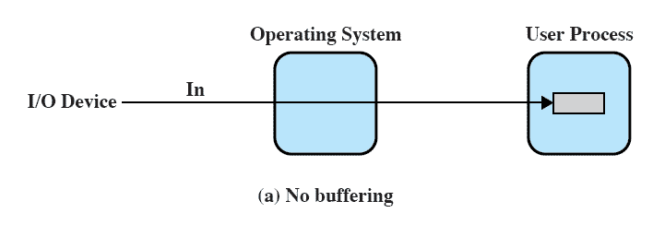
No Buffer
Input/Output
Without a buffer, the OS directly accesses a device as and when needed.

Slide 5
Single Buffer
Input/Output
When a user process issues an I/O request, the operating system assigns a buffer in the system portion of main memory.
Input transfers are made to the system buffer. When the transfer is complete, the process moves the block into user space and immediately requests another block.

Slide 6
Single Buffer
Input/Output
When a user process issues an I/O request, the operating system assigns a buffer in the system portion of main memory for an I/O request.
For block-oriented devices, the single buffering
scheme can be described as follows:
Block-Oriented
  Input transfers are made to system buffer
  When the transfer is complete the process moves the block to user space.
  Immediately another block is moved into the buffer

Slide 7
Input/Output
Block-Oriented
  User process can work/process on one block of data while next block is read in

Slide 8
Input/Output
Stream-Oriented
  Used a line at a time
  User input from a terminal is one line at a time
  Output to the terminal is one line at a time

Slide 9
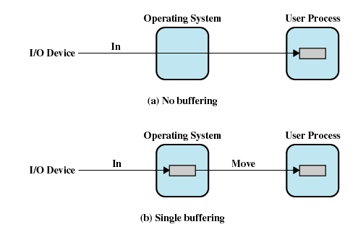
I/O Buffering
Input/Output

Slide 10
Double Buffer
Input/Output
An improvement over single buffering can be done by assigning two system buffers to operation. A process now transfers data to one buffer while the operating system empties the other. This technique is known as double buffering or buffer swapping.
Use two system buffers instead of one
A process can transfer data to or from one buffer while the operating system empties or fills the other buffer

Slide 11
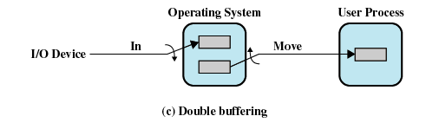
Double Buffer
Input/Output

Slide 12
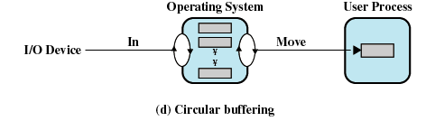
Circular Buffer
Input/Output
Double buffering may be inadequate if the process performs rapid bursts of I/O. In this case, the problem can be solved by using more than one buffer. When more than two buffers are used, the collection of buffers is itself referred to as a circular buffer.

Slide 13
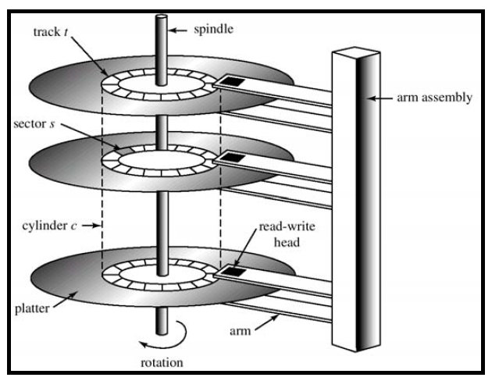
Input/Output
Moving Head Disk Mechanism

Slide 14
Disk Performance Parameters
Input/Output
To read or write, the disk head must be positioned at the desired track and at the beginning of the desired sector
Seek Time
  Time it takes to position the head at the desired track
Rotational Delay or Rotational Latency
  Time it takes for the beginning of the sector to reach the head

Slide 15
Input/Output
Access time
  Sum of seek time and rotational delay
  The time it takes to get in position to read or write
Data transfer occurs as the sector moves under the head

Slide 16
Disk Scheduling Algorithms
Input/Output
A hard disk drive is a collection of plates called platters. The surface of each platter is divided into circular tracks. Further more, each track is divided into smaller pieces called sectors. Disk I/O is done sector by sector. A group of tracks that are positioned on top of each other form a cylinder. There is a head connected to an arm for each surface, which handles all I/O operations.
For each I/O request, first head is selected. It is then moved over the destination track. The disk is then rotated to position the desired sector under the head and finally, the read/write operation is performed.

Slide 17
Input/Output
Moving Head Disk Mechanism

Slide 18
Disk Queues
Each disk has a queue of jobs waiting to access disk
  read jobs
  write jobs
Each entry in queue contains the following
  pointer to memory location to read/write from/to
  sector number to access
  pointer to next job in the queue
OS usually maintains this queue

Slide 19
Disk Queues
Entry 3
Entry 2
Entry 1
Sector Z
Mem Ptr 2
next entry
Sector Y
Mem Ptr 1
next entry
Sector X
Mem Ptr 0
next entry
head
tail
Disk

Slide 20
WHY Disk Scheduling Algorithms?
Input/Output
In a multiprogramming environment, for a single disk, there will be a number of I/O requests (read & write) from various processes in the queue.
If we select items from the queue in random order, then we expect that the track to be visited will occur randomly, giving poor performance.

Slide 21
First-Come-First Serve (FCFS)
Input/Output
Illustration-1
Several algorithms exist to schedule the servicing of disk I/O requests.
We illustrate them with a request queue (0-199).
98, 183, 37, 122, 14, 124, 65, 67
Head pointer 53

Slide 22

FCFS
Input/Output
Illustration shows total head movement of 640 cylinders.

Slide 23
FCFS
Input/Output
Reference String: 98, 183, 37, 122, 14, 124, 65, 67
Head starts at 53
67
2
65
59
124
110
14
108
122
85
37
146
183
85
98
45
53
tail
head
Calculation of total seek distance:
45+85 + 146 + 85 + 108 + 110 + 59 + 2 = 640

Slide 24
FCFS
Input/Output
Illustration-2
Reference String: 5, 35, 2, 14, 12, 21, 3, 9, 22, 20
20
2
22
12
9
6
3
18
21
9
12
2
14
12
2
33
35
30
5
tail
head
Calculation of total seek distance:
30 + 33 + 12 + 2 + 9 + 18 + 6 + 12 + 2 = 124

Slide 25
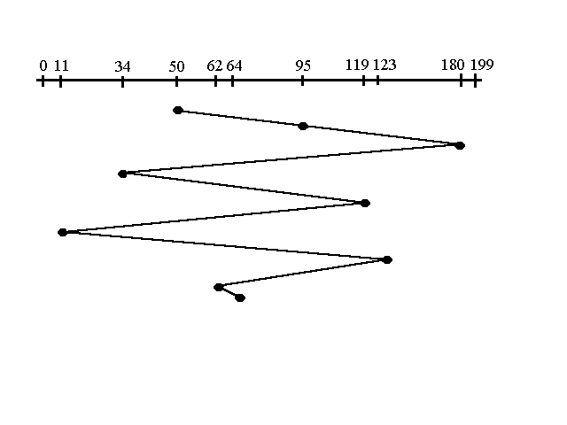
FCFS
Input/Output
Illustration-3
95, 180, 34, 119, 11, 123, 62, 64 with the Read-write head initially at the track 50
Illustration shows total head movement of ??? cylinders.

Slide 26
FCFS
Input/Output
Reference String: 95, 180, 34, 119, 11, 123, 62, 64
Head starts at 50
64
6
62
18
123
9
11
2
119
12
34
33
180
30
95
45
50
tail
head
Calculation of total seek distance:
45+30 + 33 + 12 + 2 + 9 + 18 + 6 = 155

Slide 27
Input/Output
First-In-First-Out (FIFO) OR FCFS
Perform operations in order requested
No starvation: every request is serviced
Poor performance
  OR
  Process request sequentially
  Fair to all processes

Slide 28
Input/Output
SSTF (Shortest Seek Time First)
After a request, go to the closest request in the work queue, regardless of direction
Select the disk I/O request that requires the least movement of the disk arm from its current position
Reduces total seek time compared to FCFS
Selects the request with the minimum seek time from the
current head position.
5. SSTF scheduling is a form of SJF scheduling; may cause
starvation of some requests.

Slide 29

SSTF (Shortest Seek Time First)
Input/Output
Illustration-1

Slide 30
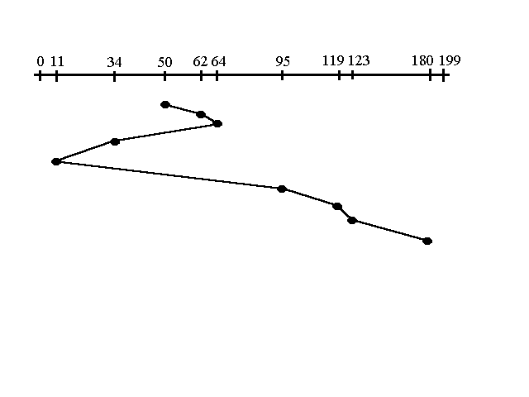
Input/Output
Illustration-2
95, 180, 34, 119, 11, 123, 62, 64 with the Read-write head initially at the track 50

Slide 31
SSTF
95, 180, 34, 119, 11, 123, 62, 64 with the Read-write head initially at the track 50
180
57
123
4
119
24
95
84
11
23
34
30
64
2
62
12
50
tail
head
Calculation of total seek distance:
12+2+30+23+84+24+4+57 = 236

Slide 32
SSTF
Illustration-3
Reference String: 5, 35, 2, 14, 12, 21, 3, 9, 22, 20
35
13
22
1
21
1
20
6
14
2
12
3
9
7
2
1
3
2
5
tail
head
Calculation of total seek distance:
2 + 1 + 7 + 3 + 2 + 6 + 1 + 1 + 13 = 35

Slide 33
SCAN (Elevator)
Input/Output
Similar to SSTF
The disk arm starts at one end of the disk, and moves toward the other end, servicing requests until it gets to the other end of the disk or until it reaches the last track in that direction.
It scans down towards the nearest end.
Sometimes called the elevator algorithm.

Slide 34
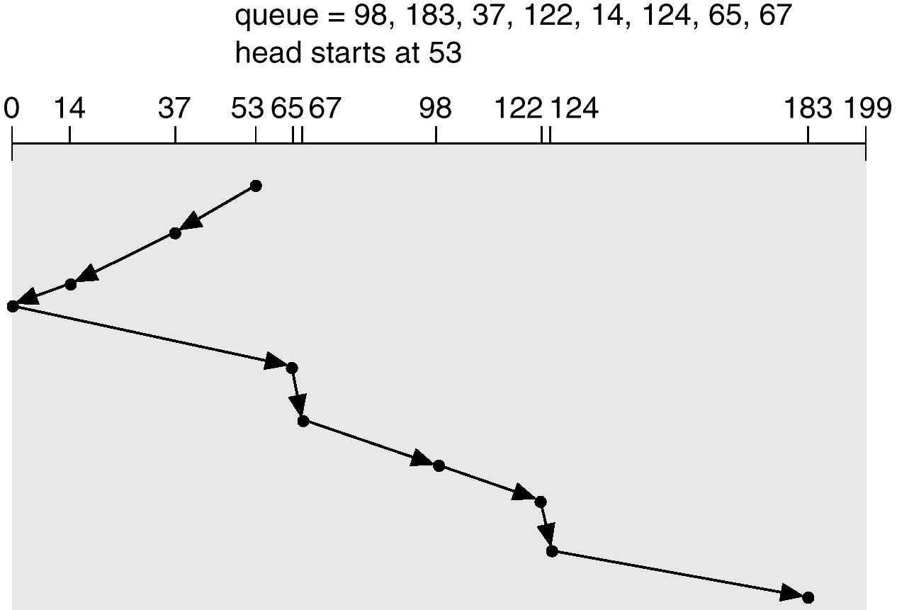
Illustration-1
Input/Output

Slide 35
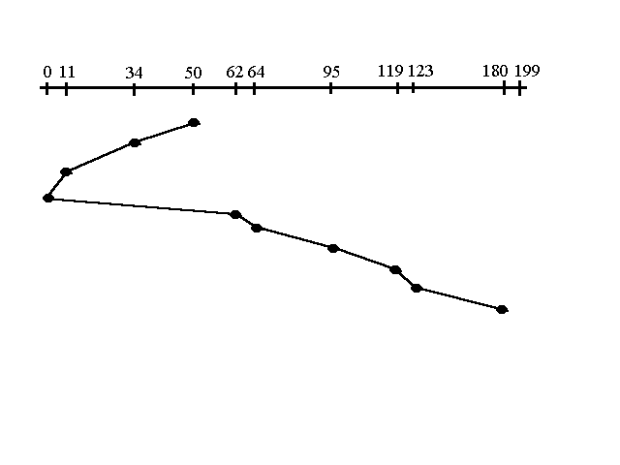
Illustration-2
Input/Output
95, 180, 34, 119, 11, 123, 62, 64 with the Read-write head initially at the track 50

Slide 36
95, 180, 34, 119, 11, 123, 62, 64 with the Read-write head initially at the track 50
180
57
123
4
119
24
95
31
64
2
62
62
0
11
11
23
34
16
50
tail
head
Total head movement
Calculation of total seek distance:
16+23+11+62+2+31+24+4+57 = 230

Slide 37
C-SCAN (Circular Scan)
Input/Output
One-Way Elevator Algorithm
The head moves from one end of the disk to the other, servicing requests as it goes.
When it reaches the other end, it immediately returns to the beginning of the disk, without servicing any requests on the return trip.
Circular scanning works just like the elevator to some extent. It begins its scan toward the nearest end and works it way all the way to the end of the system. Once it hits the bottom or top it jumps to the other end and moves in the same direction.

Slide 38

Illustration-1
Input/Output

Slide 39
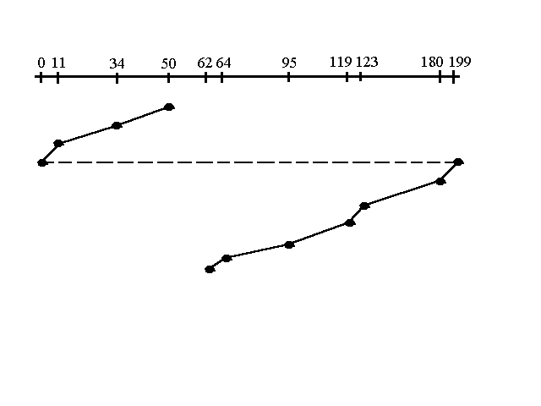
Illustration-2
Input/Output
95, 180, 34, 119, 11, 123, 62, 64 with the Read-write head initially at the track 50
This will require one long seek after finished going up have to go back to the beginning.
This is OK because one long seek doesn’t take very long
IBM disk: 15 ms from one end to the other
This long seek is done infrequently
NOTE: The huge jump doesn't count as a head movement

Slide 40
95, 180, 34, 119, 11, 123, 62, 64 with the Read-write head initially at the track 50
64
31
95
24
119
4
123
57
180
19
199
0
11
11
23
34
16
50
2
62
head
Total head movement of 187 tracks.
tail
Calculation of total seek distance:
16+23+11+19+57+4+24+31+2 = 187

Slide 41
One-Way Elevator Algorithm
Illustration-3
Reference String: 5, 35, 2, 14, 12, 21, 3, 9, 22, 20
3
1
2
33
35
13
22
1
21
1
20
6
14
2
12
3
9
4
5
tail
head
Total head movement of 64 tracks.
Calculation of total seek distance:
4 + 3 + 2 + 6 + 1 + 1 + 13 + 33 + 1 = 64

Slide 42
C-Look (Circular Look)
Input/Output
This is just an enhanced version of C-SCAN.
In this the scanning doesn't go past the last request in the direction that it is moving.
It too jumps to the other end but not all the way to the end.
C-SCAN had a total movement of 187 but this scan (C-LOOK) reduced it down to 157 tracks.

Slide 43
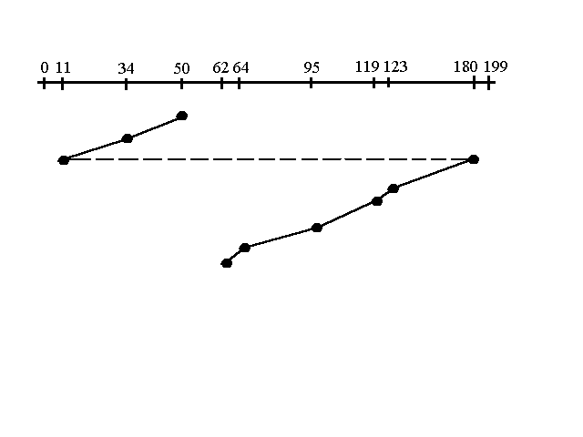
Input/Output
95, 180, 34, 119, 11, 123, 62, 64 with the Read-write head initially at the track 50
Total head movement of 157 tracks
Keep in mind that the huge jump doesn't count as a head movement

Slide 44
Input/Output
Priority (PRI)
  Goal is not to optimize disk use but to meet other objectives.
  Short batch jobs may have higher priority than longer jobs that require longer computation.
  Longer jobs may have to wait for long time.

